Slide 1
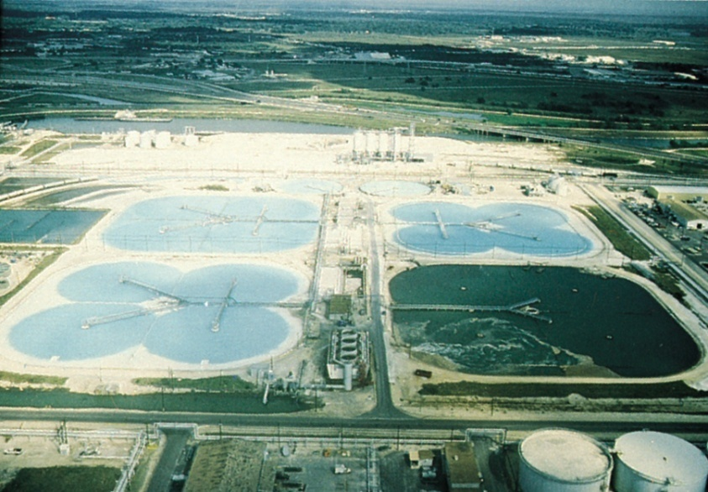
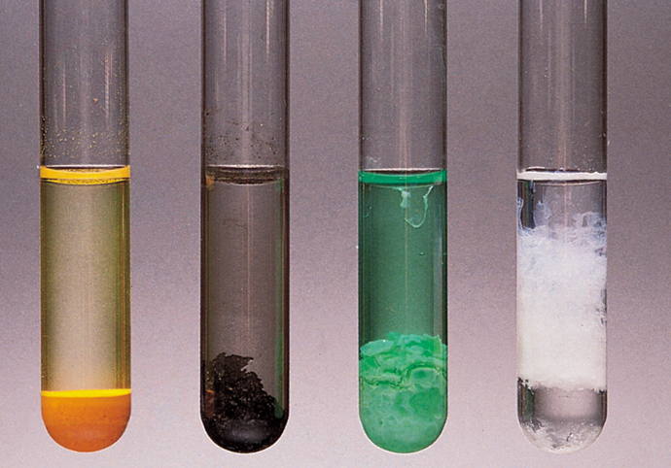
Reactions in Aqueous Solution
Chapter 4
Copyright © The McGraw-Hill Companies, Inc. Permission required for reproduction or display.

Slide 2
Many chemical reactions and virtually all biological precesses take place in water – the so called universal solvent.
Three categories of ractions occur in aqueous solutions:
precipitations reactions
acid-base reactions
redox reactions
We begin with general properties of aqueous solutions.

Slide 3
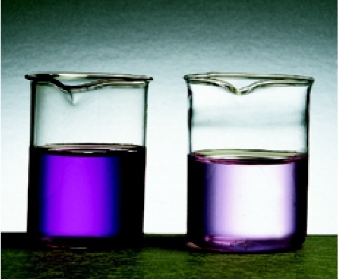
Solution, Solute & Solvent
A solution is a homogenous mixture of 2 or more substances.
The solute is the substance present in the smaller amount.
The solvent is the substance present in the larger amount.
Solution
Solvent
Solute
Air (g)
N₂
O₂, Ar, CH₄
Soft drink (l)
H₂O
Sugar, CO₂
Pb
Sn
aqueous solutions of KMnO₄
Soft Solder (s)

Slide 4
Solution, Solute & Solvent
So, a solution may be:
gaseous (such as air)
liquid (such as seawater)
solid (such as an alloy)
Here we will discuss only aqueous solution
in which the solute is a solid or liquid, and the sovent is water
All solute that dissolve in water fit into two types:
Electrolyte and Nonelectrolyte
Electrolytes are of two categories:
Strong electrolyte and Weak electrolyte

Slide 5
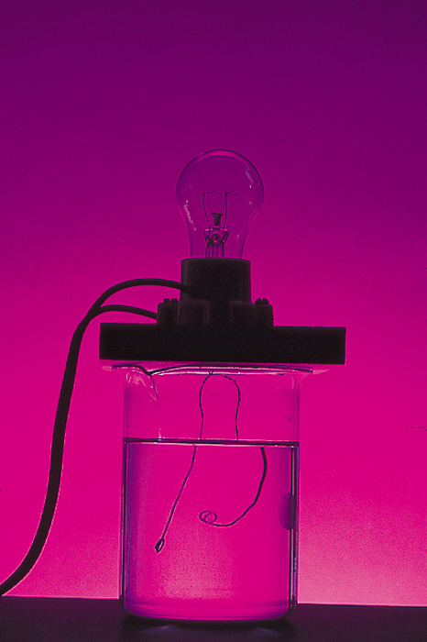
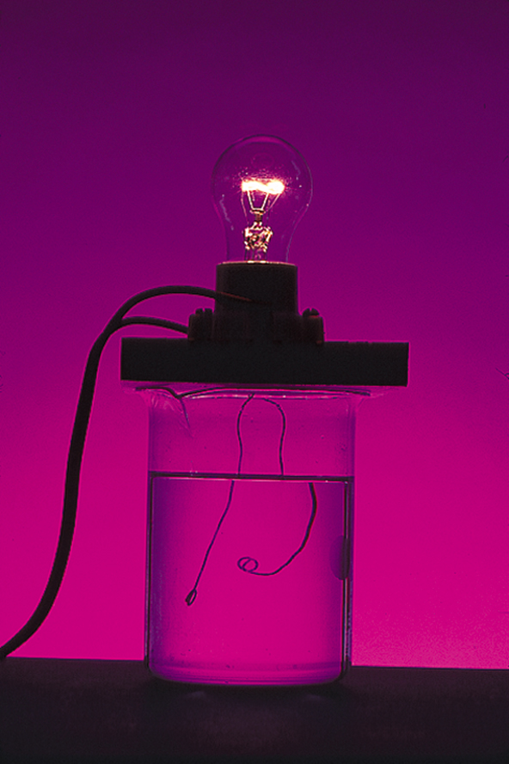
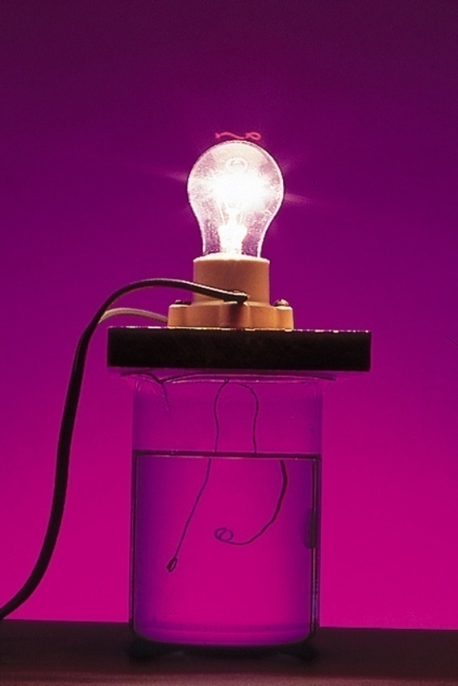
Electrolyte & Nonelectrolyte
An electrolyte is a substance that, when dissolved in water, results in a solution that can conduct electricity.
A nonelectrolyte is a substance that, when dissolved, results in a solution that does not conduct electricity.
nonelectrolyte
weak electrolyte
strong electrolyte

Slide 6
Electrolyte & Nonelectrolyte
Conduct electricity in solution?
Cations (+) and Anions (-)
Strong Electrolyte – 100% dissociation
H₂O
NaCl (s) Na⁺ (aq) + Cl⁻ (aq)
Weak Electrolyte – not completely dissociated
CH₃COOH CH₃COO⁻ (aq) + H⁺ (aq)

Slide 7
Electrolyte & Nonelectrolyte
Ionization of acetic acid
CH₃COOH CH₃COO⁻ (aq) + H⁺ (aq)
A reversible reaction. The reaction can occur in both directions.
Reaches an equilibrium.
Acetic acid is a weak electrolyte because its ionization in water is incomplete.

Slide 8
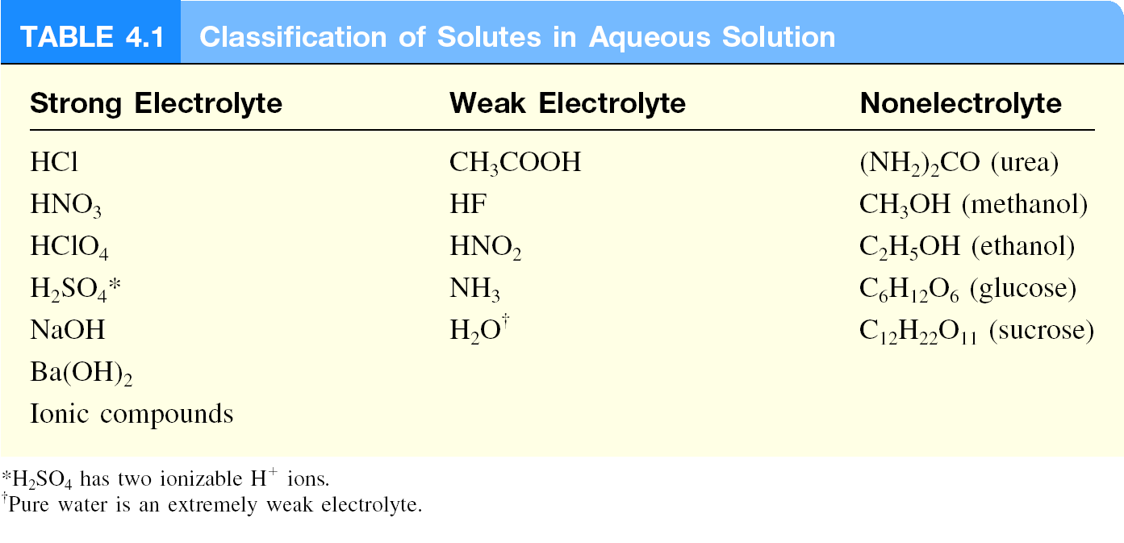
Electrolyte & Nonelectrolyte
Nonelectrolyte does not conduct electricity?
No cations (+) and anions (-) in solution
H₂O
C₆H₁₂O₆ (s) C₆H₁₂O₆ (aq)

Slide 9
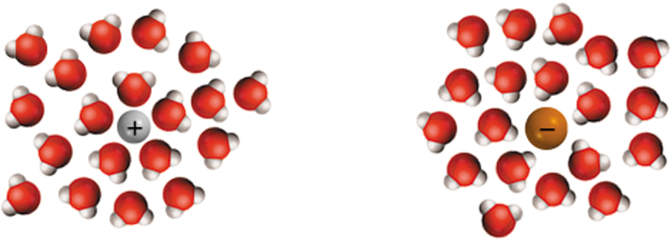
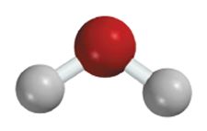
Solution Process
Hydration is the process in which an ion is surrounded by water molecules arranged in a specific manner.
δ⁻
δ⁺
H₂O

Slide 10
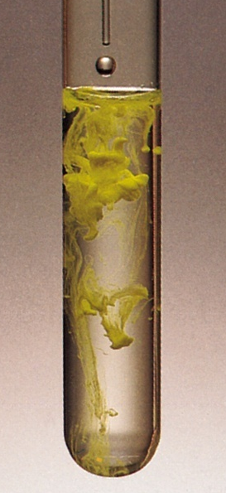
Precipitation Reactions
Precipitate – insoluble solid that separates from solution
precipitate
Pb(NO₃)₂ (aq) + 2NaI (aq) PbI₂ (s) + 2NaNO₃ (aq)
molecular equation
Pb²⁺ + 2NO₃⁻ + 2Na⁺ + 2I⁻ PbI₂ (s) + 2Na⁺ + 2NO₃⁻
ionic equation
Pb²⁺ + 2I⁻ PbI₂ (s)
PbI₂
net ionic equation
Na⁺ and NO₃⁻ are spectator ions

Slide 11
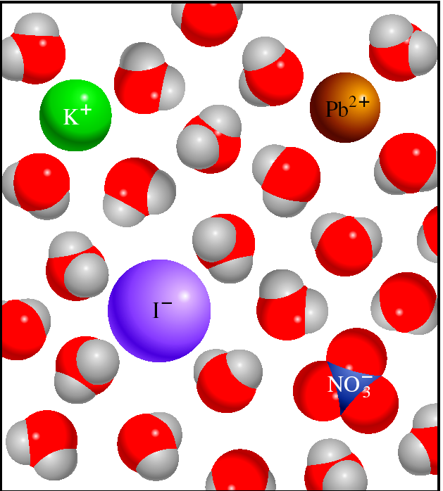
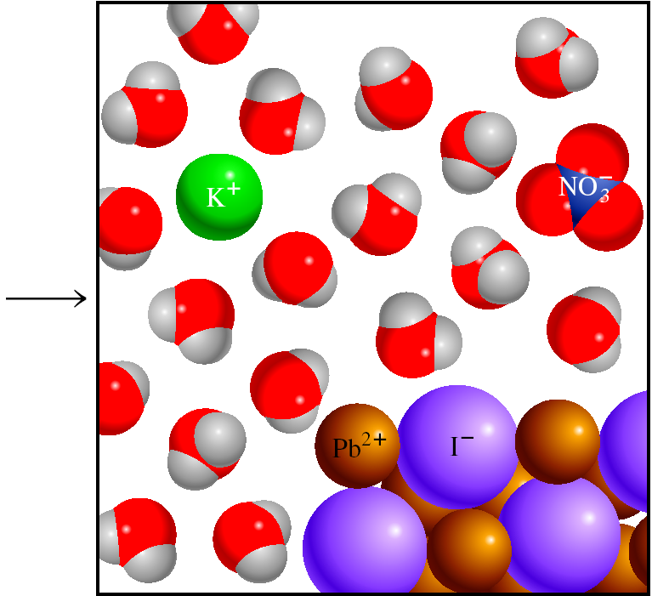
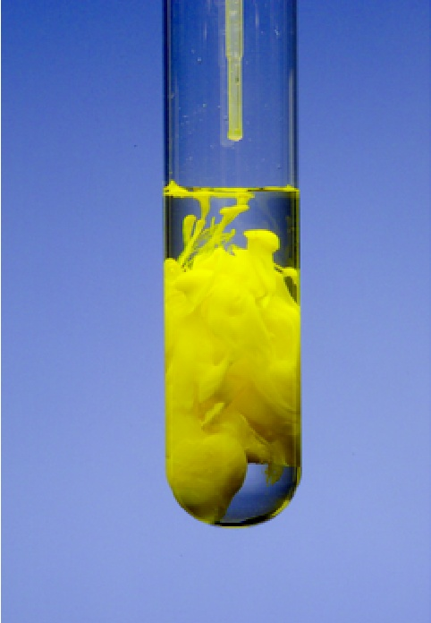
Precipitation of Lead Iodide
Pb²⁺ + 2I⁻ PbI₂ (s)
PbI₂

Slide 12
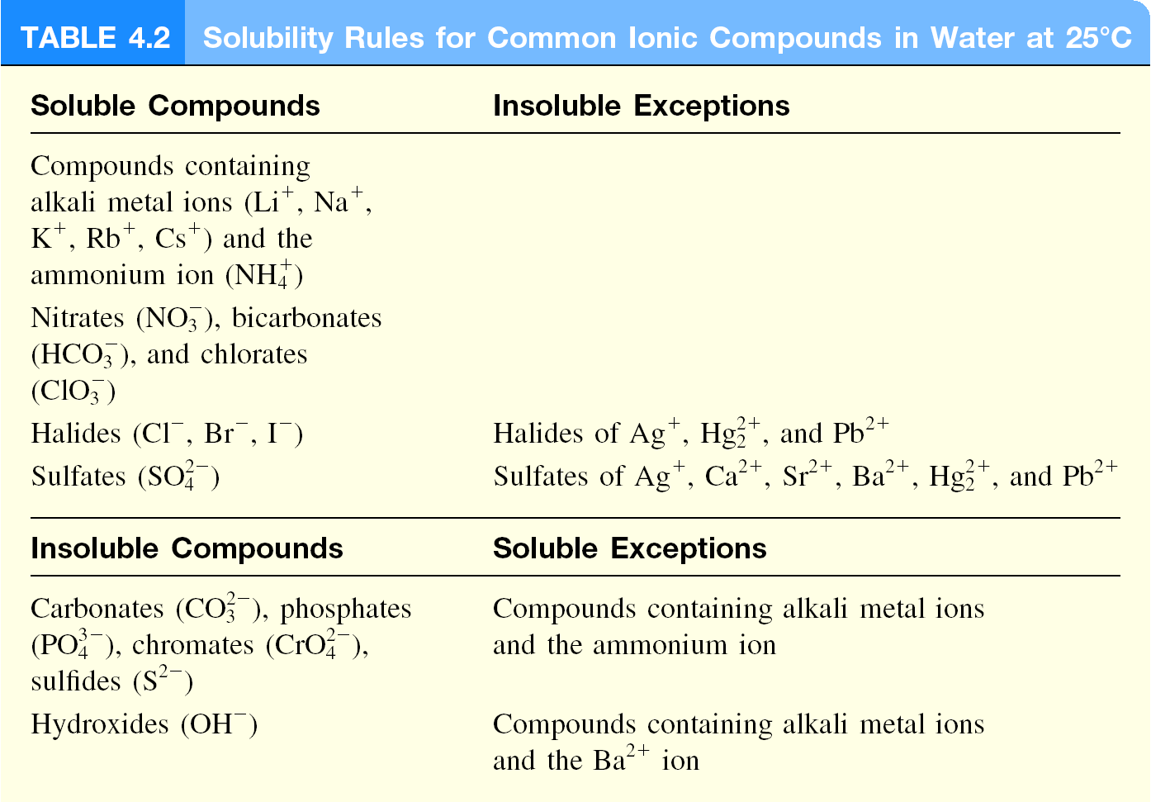
Solubility is the maximum amount of solute that will dissolve in a given quantity of solvent at a specific temperature.

Slide 13
Identify each of the following species as a soluble or insoluble:
Siver sulfate, Ag₂SO₄
Insoluble
Calcium carbonate, CaCO₃
Insoluble
Sodium phosphate, Na₃PO₄
Soluble
Copper sulfide, CuS
Insoluble
Calcium hydroxide, Ca(OH)₂
Insoluble
Zinc nitrate, Zn(NO₃)₂
Soluble

Slide 14
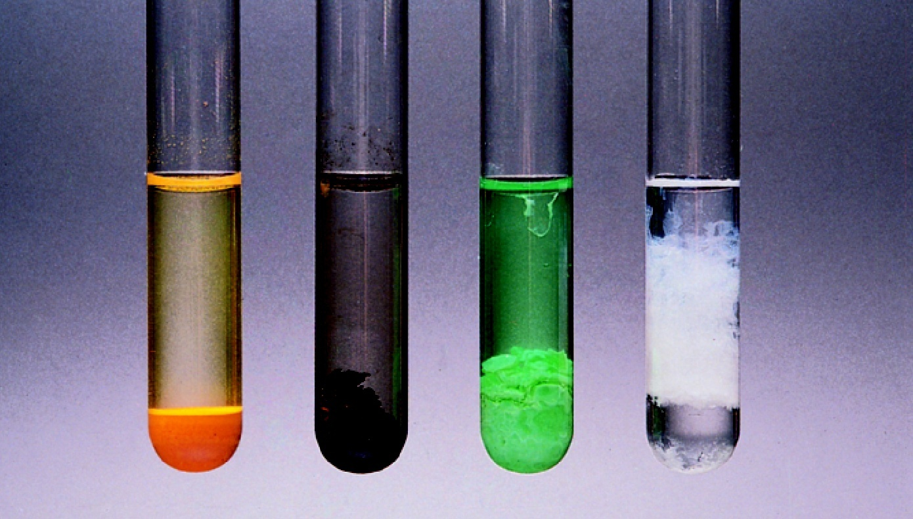
Examples of Insoluble Compounds
CdS
PbS
Ni(OH)₂
Al(OH)₃

Slide 15
Writing Net Ionic Equations
Write the balanced molecular equation.
Write the ionic equation showing the strong electrolytes completely dissociated into cations and anions.
Cancel the spectator ions on both sides of the ionic equation
Check that charges and number of atoms are balanced in the net ionic equation
Write the net ionic equation for the reaction of silver nitrate with sodium chloride.
AgNO₃(aq) + NaCl(aq) AgCl(s) + NaNO₃(aq)
Ag⁺ + NO₃⁻ + Na⁺ + Cl⁻ AgCl(s) + Na⁺ + NO₃⁻
Ag⁺ + Cl⁻ AgCl(s)

Slide 16
Predict what happens when a potassium phosphate K₃PO₄ solution is mixed with a strontium nitrate Sr(NO₃)₂ solution. Write the ionic and net ionic equation for the reaction.
2K₃PO₄(aq) + 3Sr(NO₃)₂(aq)
→ Sr₃(PO₄)₂(s) + 6KNO₃(aq)
Ionic:
6K⁺(aq) + 2PO₄³⁻(aq) + 3Sr²⁺(aq) + 6NO₃⁻(aq)
→ Sr₃(PO₄)₂(s) + 6K⁺(aq) + 6NO₃⁻(aq)
Net ionic:
3Sr₂⁺(aq) + 2PO₄³⁻(aq) → Sr₃(PO₄)₂(s)

Slide 17
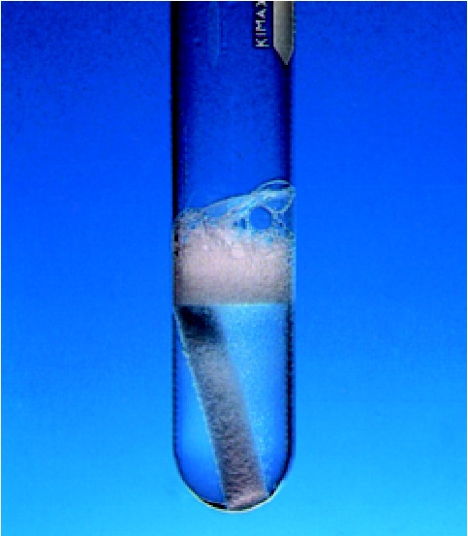
Acid-Base Reactions
Properties of Acids
Have a sour taste. Vinegar owes its taste to acetic acid. Citrus fruits contain citric acid.
Cause color changes in plant dyes.
React with certain metals to produce
hydrogen gas.
2HCl(aq) + Mg(s) MgCl₂(aq) + H₂(g)
React with carbonates and bicarbonates
to produce carbon dioxide gas
2HCl(aq) + CaCO₃(s) CaCl₂(aq) + CO₂(g) + H₂O(l)
Aqueous acid solutions conduct electricity.

Slide 18
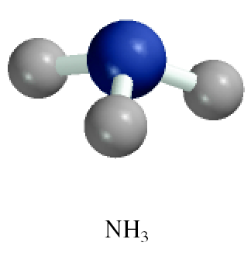
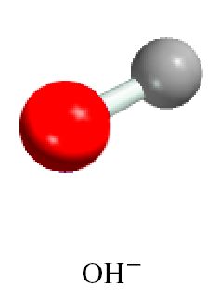
Acid-Base Reactions
Properties of Bases
Have a bitter taste.
Feel slippery. Many soaps contain bases.
Cause color changes in plant dyes.
Aqueous base solutions conduct electricity.
Examples:

Slide 19
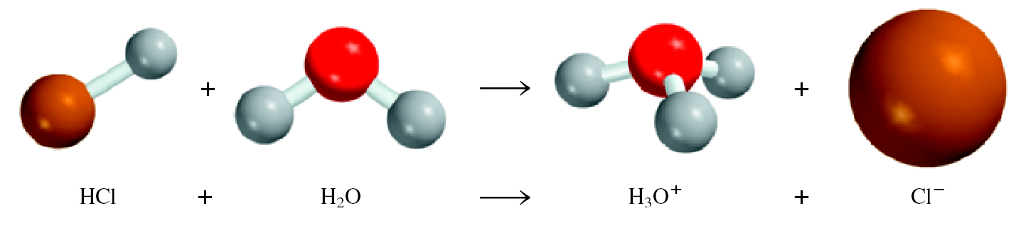
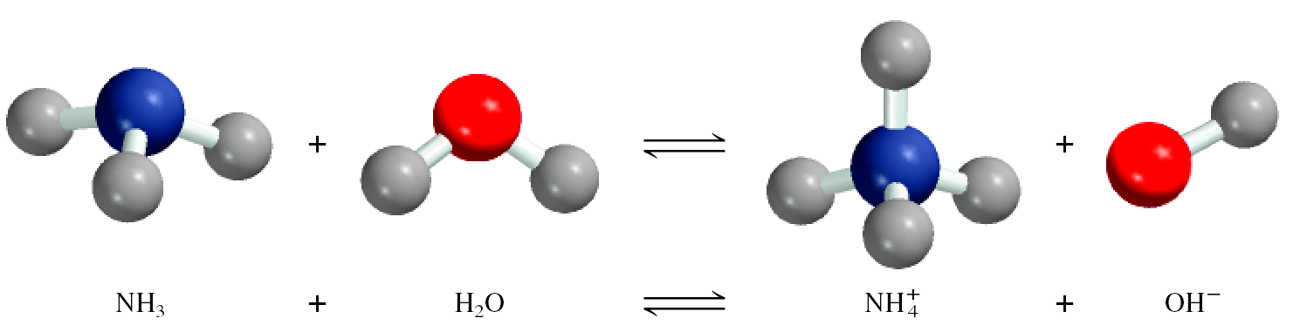
Arrhenius Acid & Base
Arrhenius acid is a substance that produces H⁺ (H₃O⁺) in water.
Arrhenius base is a substance that produces OH⁻ in water.

Slide 20
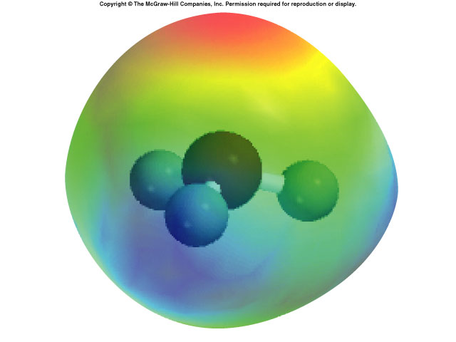
Hydronium ion, hydrated proton, H₃O⁺

Slide 21
Brønsted Acid & Base
A Brønsted acid is a proton donor.
A Brønsted base is a proton acceptor.
base
acid
acid
base
A Brønsted acid must contain at least one ionizable proton!

Slide 22
Mono-, Di- & Triprotic Acids
Monoprotic acids
HCl H⁺ + Cl⁻
Strong electrolyte, strong acid
HNO₃ H⁺ + NO₃⁻
Strong electrolyte, strong acid
CH₃COOH H⁺ + CH₃COO⁻
Weak electrolyte, weak acid
Diprotic acids
H₂SO₄ H⁺ + HSO₄⁻
Strong electrolyte, strong acid
HSO₄⁻ H⁺ + SO₄²⁻
Weak electrolyte, weak acid
Triprotic acids
H₃PO₄ H⁺ + H₂PO₄⁻
Weak electrolyte, weak acid
H₂PO₄⁻ H⁺ + HPO₄²⁻
Weak electrolyte, weak acid
HPO₄²⁻ H⁺ + PO₄³⁻
Weak electrolyte, weak acid

Slide 23
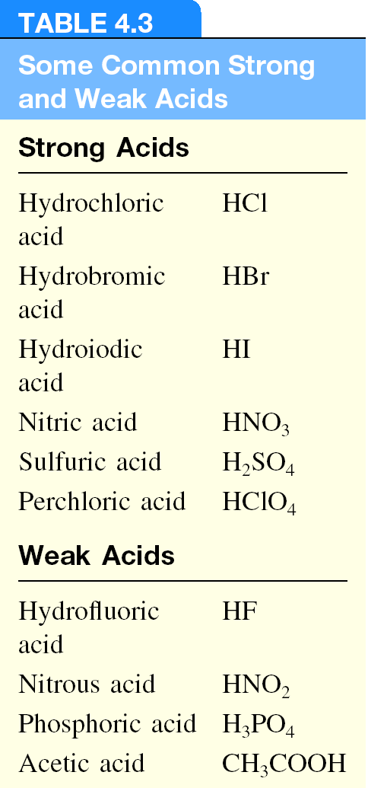

Slide 24
Identify each of the following as a Brønsted acid, base, or both. (a) HI, (b) CH₃COO⁻, (c) H₂PO₄⁻, (d) HSO₄⁻
HI (aq) H⁺ (aq) + I⁻ (aq)
Brønsted acid
CH₃COO⁻ (aq) + H⁺ (aq) CH₃COOH (aq)
Brønsted base
H₂PO₄⁻ (aq) H⁺ (aq) + HPO₄²⁻ (aq)
Brønsted acid
H₂PO₄⁻ (aq) + H⁺ (aq) H₃PO₄ (aq)
Brønsted base
HSO₄⁻ (aq) H⁺ (aq) + SO₄²⁻ (aq)
Brønsted acid
HSO₄⁻ (aq) + H⁺ (aq) H₂SO₄ (aq)
Brønsted base

Slide 25
Neutralization Reaction
acid + base salt + water
HCl(aq) + NaOH(aq) NaCl(aq) + H₂O
H⁺ + Cl⁻ + Na⁺ + OH⁻ Na⁺ + Cl⁻ + H₂O
H⁺ + OH⁻ H₂O

Slide 26
Neutralization Reaction Involving a Weak Electrolyte
weak acid + base salt + water
HCN(aq) + NaOH(aq) NaCN(aq) + H₂O
HCN + Na⁺ + OH⁻ Na⁺ + CN⁻ + H₂O
HCN + OH⁻ CN⁻ + H₂O

Slide 27
Neutralization Reaction Producing a Gas
acid + base salt + water + CO₂
2HCl(aq) + Na₂CO₃(aq) 2NaCl(aq) + H₂O +CO₂
2H⁺ + 2Cl⁻ + 2Na⁺ + CO₃²⁻ 2Na⁺ + 2Cl⁻ + H₂O + CO₂
2H⁺ + CO₃²⁻ H₂O + CO₂

Slide 28
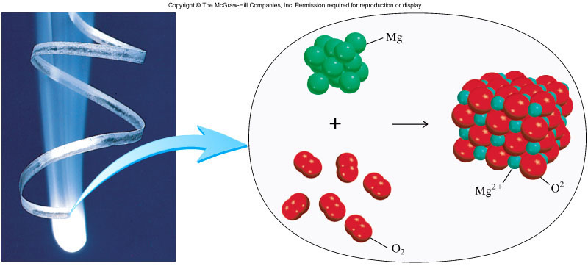
Oxidation-Reduction Reactions
(electron transfer reactions)
2Mg 2Mg²⁺ + 4e⁻
Oxidation half-reaction (lose e⁻)
O₂ + 4e⁻ 2O²⁻
Reduction half-reaction (gain e⁻)
2Mg + O₂ + 4e⁻ 2Mg²⁺ + 2O²⁻ + 4e⁻
2Mg + O₂ 2MgO

Slide 29
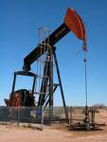
Oxidation-Reduction Reactions
(electron transfer reactions)
Oxidation Is Loss of e⁻ Reduction Is Gain of e⁻
OILRIG

Slide 30
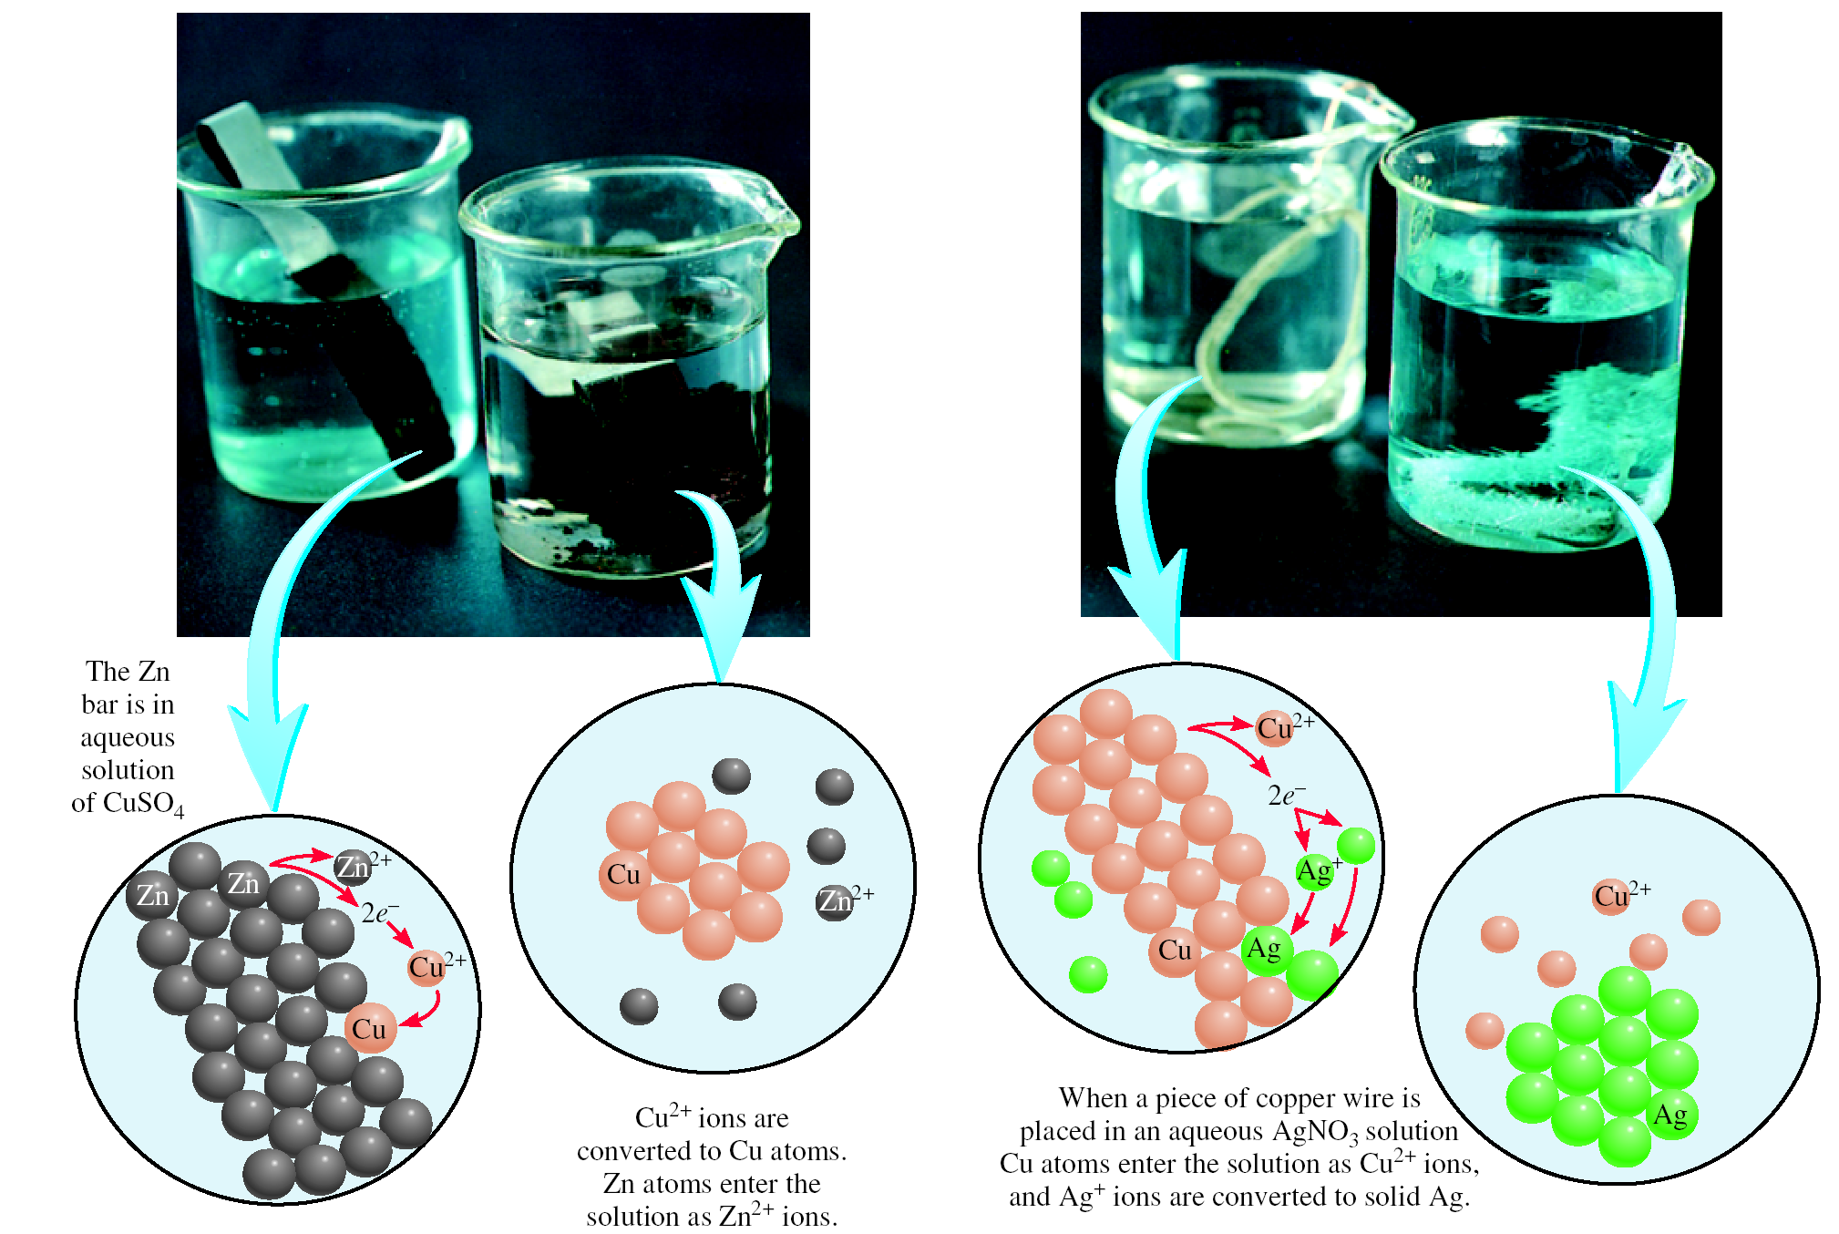

Slide 31
Zinc bar reacts with copper(II) sulfate to form copper metal. Write the redox reaction, half-reactions & identify the oxidizing agent, reducing agent.
Zn(s) + CuSO₄(aq) ZnSO₄(aq) + Cu(s)
Zn Zn²⁺ + 2e⁻
Zn is oxidized
Zn is the reducing agent
Cu²⁺ + 2e⁻ Cu
Cu²⁺ is reduced
Cu²⁺ is the oxidizing agent
Copper wire reacts with silver nitrate to form silver metal. Write the redox reaction, half-reactions & identify the oxidizing agent, reducing agent.
Cu(s) + 2AgNO₃(aq) Cu(NO₃)₂(aq) + 2Ag(s)
Cu Cu²⁺ + 2e⁻
Cu is oxidized
Cu is the reducing agent
Ag⁺ + e⁻ Ag
Ag⁺ is reduced
Ag⁺ is the oxidizing agent

Slide 32
Oxidation number
The charge the atom would have in a molecule (or an
ionic compound) if electrons were completely transferred.
Free elements (uncombined state) have an oxidation number of zero.
Na, Be, K, Pb, H₂, O₂, P₄ = 0
In monatomic ions, the oxidation number is equal to the charge on the ion.
Li⁺, Li = +1; Fe³⁺, Fe = +3; O²⁻, O = -2
The oxidation number of oxygen is usually –2. In H₂O₂ and O₂²⁻ it is –1.
4.4

Slide 33
The oxidation number of hydrogen is +1 except when it is bonded to metals in binary compounds. In these cases, its oxidation number is –1.
Group IA metals are +1, IIA metals are +2 and fluorine is always –1.
6. The sum of the oxidation numbers of all the atoms in a molecule or ion is equal to the charge on the molecule or ion.
7. Oxidation numbers do not have to be integers. Oxidation number of oxygen in the superoxide ion, O₂⁻, is –½.
HCO₃ ⁻
O = –2
H = +1
What are the oxidation numbers of all the elements in HCO₃⁻ ?
3x(–2) + 1 + ? = –1
C = +4

Slide 34
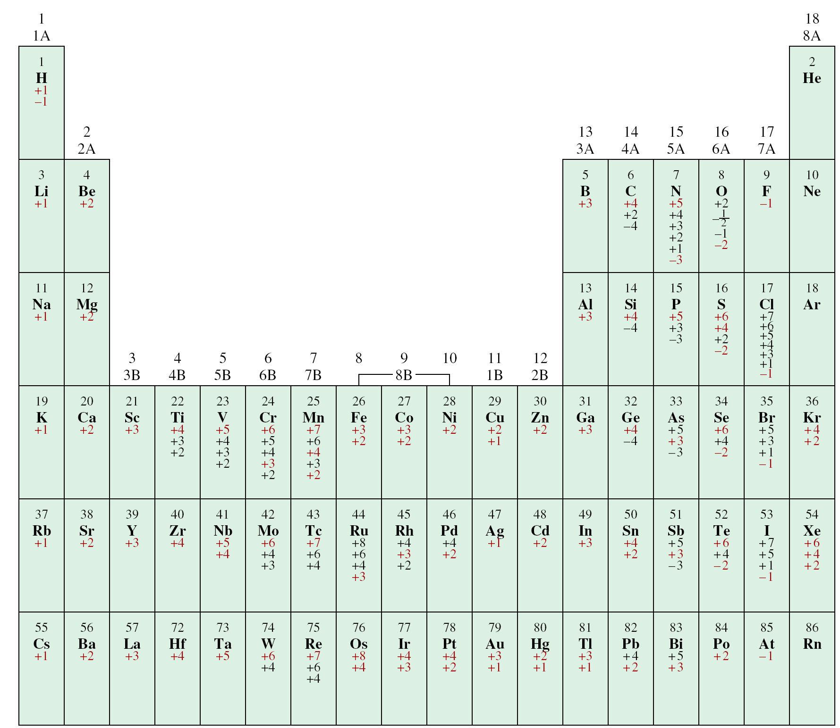
The Oxidation Numbers of Elements in their Compounds

Slide 35
What are the oxidation numbers of all the elements in each of these compounds?
NaIO₃ IF₇ K₂Cr₂O₇
IF₇
F = -1
7x(-1) + ? = 0
NaIO₃
I = +7
Na = +1
O = -2
K₂Cr₂O₇
3x(-2) + 1 + ? = 0
O = -2
K = +1
I = +5
7x(-2) + 2x(+1) + 2x(?) = 0
Cr = +6

Slide 36
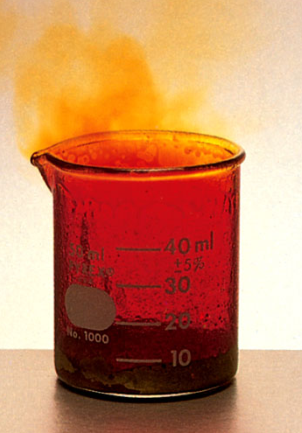
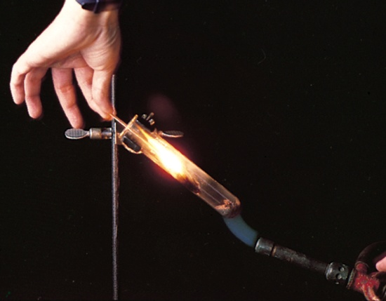
Types of Oxidation-Reduction Reactions
Combination Reaction
A + B C
0
0
+3
-1
2Al + 3Br₂ 2AlBr₃
Decomposition Reaction
C A + B
+1
+5
-2
+1
-1
0
2KClO₃ 2KCl + 3O₂

Slide 37
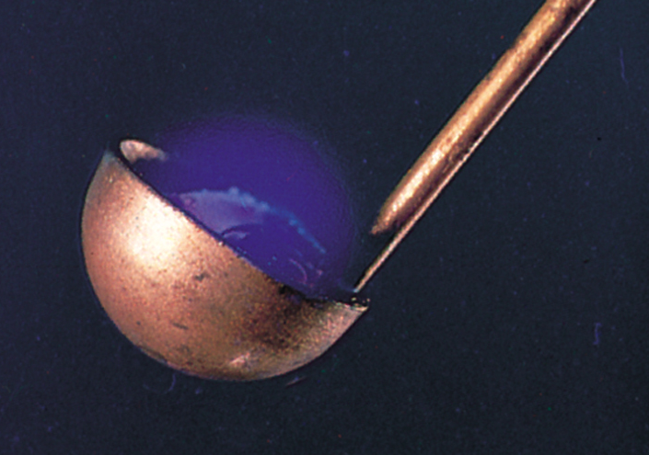
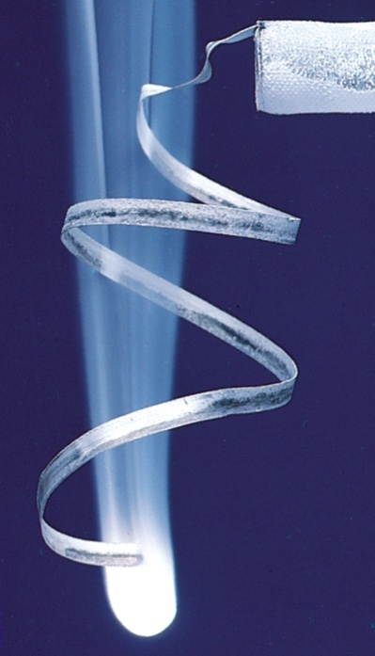
Types of Oxidation-Reduction Reactions
Combustion Reaction
A + O₂ B
0
0
+4
-2
S + O₂ SO₂
0
0
+2
-2
2Mg + O₂ 2MgO

Slide 38
Types of Oxidation-Reduction Reactions
Displacement Reaction
A + BC AC + B
0
+1
+2
0
Sr + 2H₂O Sr(OH)₂ + H₂
Hydrogen Displacement
+4
0
0
+2
TiCl₄ + 2Mg Ti + 2MgCl₂
Metal Displacement
0
-1
-1
0
Cl₂ + 2KBr 2KCl + Br₂
Halogen Displacement

Slide 39
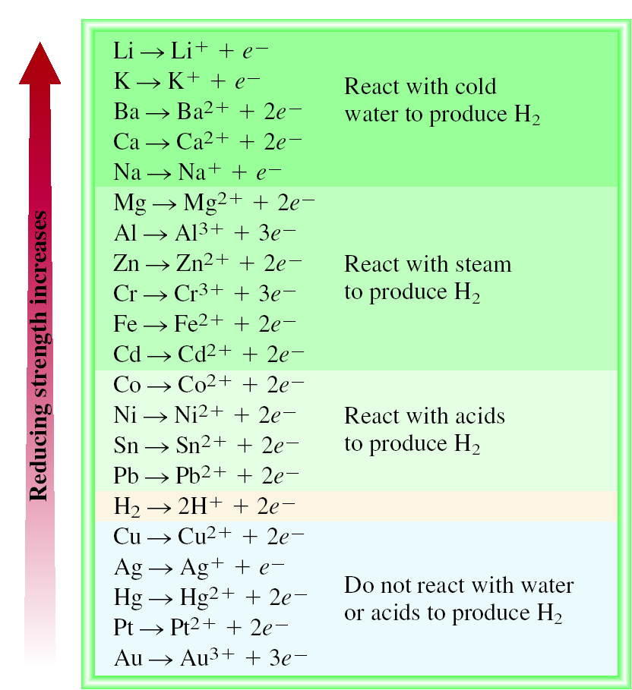
The Activity Series for Metals
Hydrogen Displacement Reaction
M + BC MC + B
M is metal
BC is acid or H₂O
B is H₂
Ca + 2H₂O Ca(OH)₂ + H₂
Pb + 2H₂O Pb(OH)₂ + H₂

Slide 40
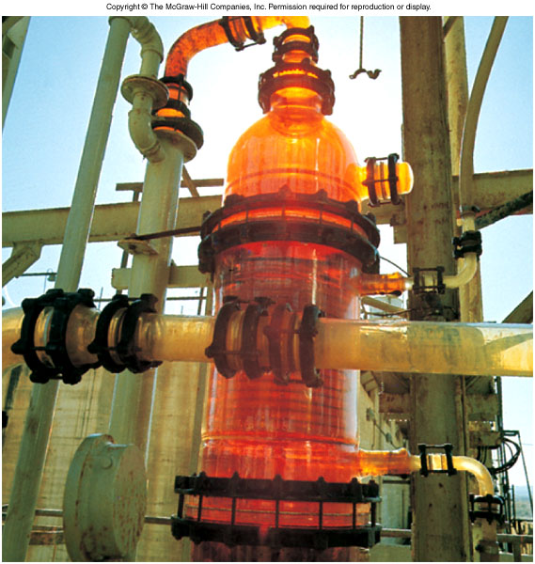
The Activity Series for Halogens
F₂ > Cl₂ > Br₂ > I₂
Halogen Displacement Reaction
0
-1
-1
0
Cl₂ + 2KBr 2KCl + Br₂
I₂ + 2KBr 2KI + Br₂

Slide 41
Types of Oxidation-Reduction Reactions
Disproportionation Reaction
The same element is simultaneously oxidized and reduced.
Example:
reduced
0
+1
-1
Cl₂ + 2OH⁻ ClO⁻ + Cl⁻ + H₂O
oxidized

Slide 42
Classify each of the following reactions.
Ca²⁺ + CO₃²⁻ CaCO₃
Precipitation
NH₃ + H⁺ NH₄⁺
Acid-Base
Zn + 2HCl ZnCl₂ + H₂
Redox (H₂ Displacement)
Ca + F₂ CaF₂
Redox (Combination)

Slide 43
Solution Stoichiometry
The concentration of a solution is the amount of solute present in a given quantity of solvent or solution.
moles of solute
M = molarity =
liters of solution
What mass of KI is required to make 500.0 mL of a 2.80 M KI solution?
M KI
M KI
volume of KI solution
moles KI
grams KI
1 L
2.80 mol KI
166 g KI
500.0 mL
x
x
x
= 232 g KI
1000 mL
1 L soln
1 mol KI

Slide 44
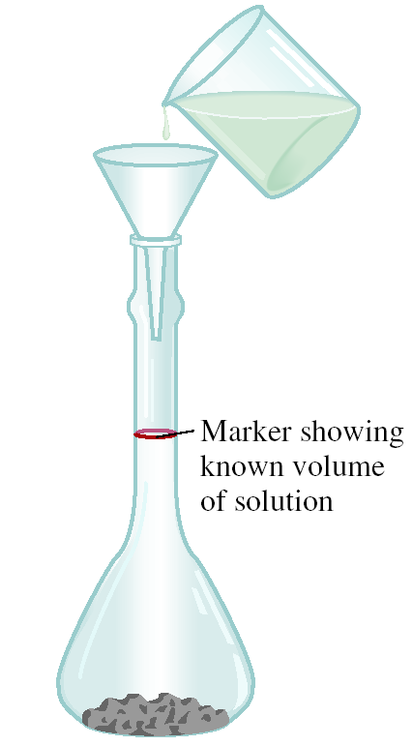
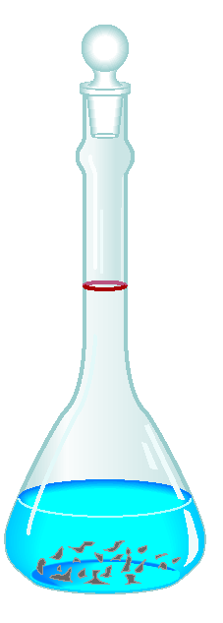
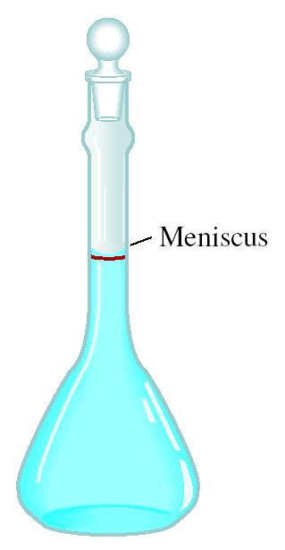
Preparing a Solution of Known Concentration

Slide 45
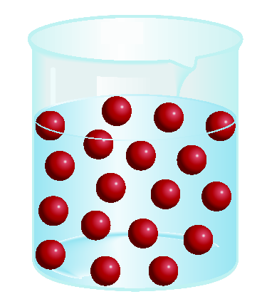
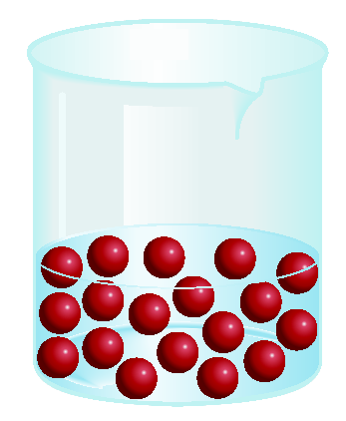
Dilution is the procedure for preparing a less concentrated solution from a more concentrated solution.
Dilution
Add Solvent
Moles of solute
before dilution (i)
=
Moles of solute
after dilution (f)
M_{i}V_{i}
=
M_{f}V_{f}

Slide 46
How would you prepare 60.0 mL of 0.200 M HNO₃ from a stock solution of 4.00 M HNO₃?
M_{i}V_{i} = M_{f}V_{f}
M_{i} = 4.00 M
M_{f} = 0.200 M
V_{f} = 0.0600 L
V_{i} = ? L
M_{f}V_{f}
0.200 M x 0.0600 L
V_{i} =
=
= 0.00300 L = 3.00 mL
M_{i}
4.00 M
Dilute 3.00 mL of acid with water to a total volume of 60.0 mL.

Slide 47
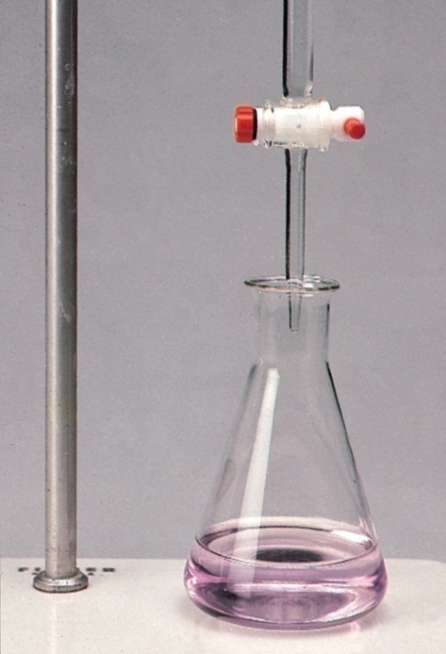
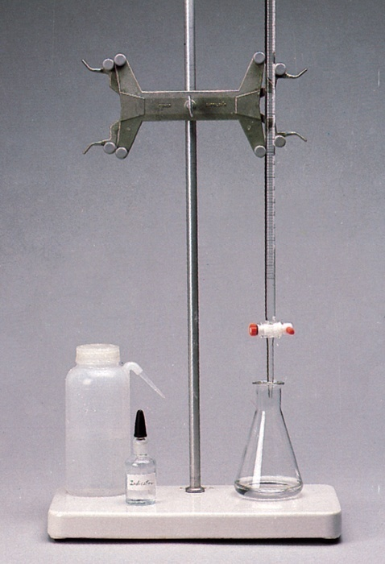
Titrations
In a titration a solution of accurately known concentration is added gradually added to another solution of unknown concentration until the chemical reaction between the two solutions is complete.
Equivalence point – the point at which the reaction is complete
Indicator – substance that changes color at (or near) the
equivalence point
Slowly add base
to unknown acid
UNTIL
the indicator
changes color

Slide 48

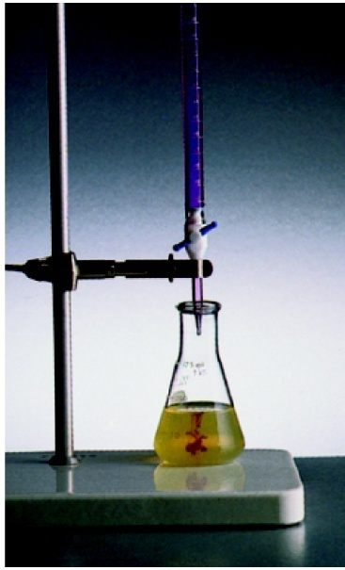
Titrations can be used in the analysis of
Acid-base reactions
Redox reactions
H₂SO₄ + 2NaOH 2H₂O + Na₂SO₄
5Fe²⁺ + MnO₄⁻ + 8H⁺ Mn²⁺ + 5Fe³⁺ + 4H₂O

Slide 49
What volume of a 1.420 M NaOH solution is required to titrate 25.00 mL of a 4.50 M H₂SO₄ solution?
WRITE THE CHEMICAL EQUATION!
H₂SO₄ + 2NaOH 2H₂O + Na₂SO₄
M
rxn
M
volume acid
moles red
moles base
volume base
acid
coef.
base
4.50 mol H₂SO₄
2 mol NaOH
1000 ml soln
25.00 mL
x
x
x
= 158 mL
1000 mL soln
1 mol H₂SO₄
1.420 mol NaOH

